Slide 1
Government Price Controls: Price Supports
Steven Suranovic
George Washington University

Slide 2
Types of Government Price Controls
Price Ceiling (L20) – a maximum price that can be charged for a product in a market
Price Floor (L21) – a minimum price that can be charged for a good or service in a market
Price Support (L22) – a price floor for a good in which the government purchases excess supply

Slide 3
Price Supports
Commonly used for Agricultural products
The intention is to provide income guarantees for farmers
Farmers that plant in the spring and harvest in the fall may discover the fall price to be too low to be profitable
A price support offers a minimum price so farmers can plan more effectively – a kind of insurance policy
If there is excess supply, the government buys it
Restricted to storable products; powdered milk, cheese, grain, butter, etc

Slide 4
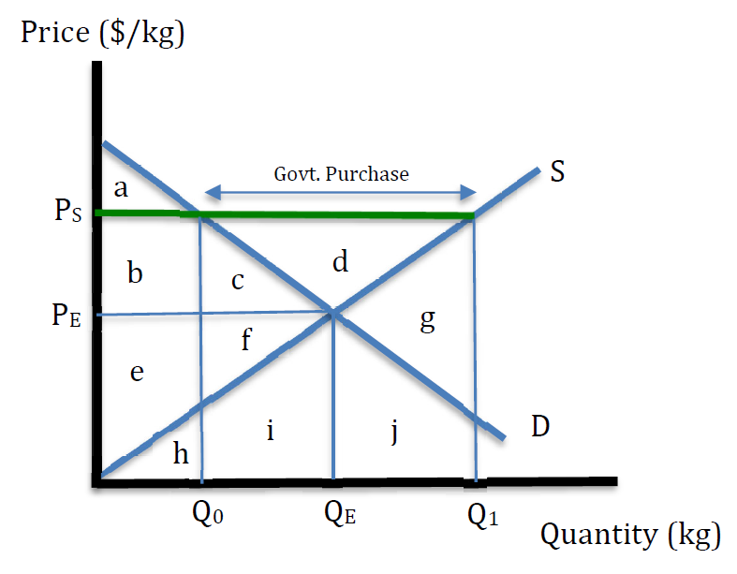
Effects of a Price Support
Consider a price support for a product set at P_{S}
Suppose the free market price at harvest is P_{E}
At P_{S}, supply will be Q₁
At P_{S}, demand will be Q₀
At P_{S}, excess supply is Q₁ – Q₀

Slide 5
Effects of a Price Support
Welfare Effects
ΔCS = - (b + c)
ΔPS = + b + c + d
ΔGR = - (c + d + f + i + j + g)
ΔMW = - (c + f + i + j + g)

Slide 6
Effects of a Price Support
Welfare Effects
Consumers of the exported good lose
Producers of the exported good benefit
Taxpayers must pay the government more
The net welfare effect is negative → Losses exceed the gains

Slide 7
Effects of a Price Support
Note that the losses to the taxpayers is exaggerated because it presumes the good is thrown away.
If the government purchased good is sold later, at a price that covers the variable production costs, then ΔGR = - (c + d + f) and
ΔMW = - c - f

Slide 8
Political Economy Issues
Why do governments often choose to implement policies that are welfare reducing?
Why implement a price support if it results in more harm than good?
Why implement an import tariff if it causes more harm than good?
Why maintain strong intellectual property protections if the intended stimulus to innovation is weak or non-existent?

Slide 9
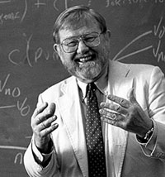
Political Economy Issues
Mancur Olson (1932 – 1998)
The Logic of Collective Action (1965)
Collective action refers to lobbying the government
Central Result: Small-sized groups are more effective than large-sized groups
Reason is that large groups suffer from coordination problems and free-riding

Slide 10
Political Economy Issues
Coordination Problems
How do you get a group of people with shared interests to participate in a collective action?
If the self-interests of each member is large, it is easier to do
Free Rider Problem
If a few people volunteer to support the collective interests, others might decide to opt out
Free riding is more likely the larger the group

Slide 11
Political Economy Issues
In economic models, winners and losers from policy actions can be classified into three groups:
Producers
relatively small-sized, concentration in an industry may result in numbers between 10-1000
Consumers
Large-sized. In US the number of consumers is in the millions to hundreds of millions
Taxpayers
Large-sized. All adults pay taxes in one form or another .. numbers in the hundreds of millions in the US

Slide 12
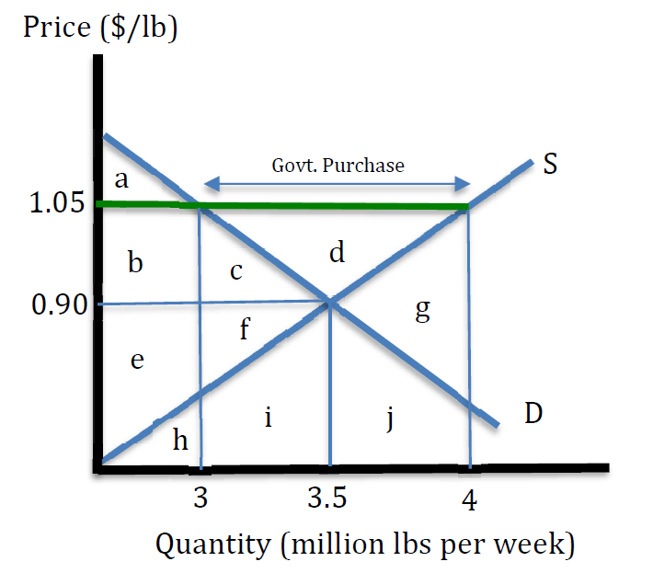
Constructed Numerical Example
Consider a price support in the market for butter. P_{S} = $1.05
Numbers used are approximately equal to real values in the butter market
Note that axes are not to scale

Slide 13
Constructed Numerical Example
Calculate consumer surplus changes
ΔCS = - (b + c) =
- (1.05 - .90)(3,000,000) -
½(.15)(3,500,000 – 3,000,000)
= - $487,500 per week
Or
- $25.35 million per year

Slide 14
Constructed Numerical Example
Calculate producer surplus changes
ΔPS = + (b + c + d) =
= $487,500 +
½ (.15)(4,000,000 – 3,000,000) =
+ $562,500 per week
Or
+ $29.25 million per year

Slide 15
Constructed Numerical Example
Calculate government revenue changes
ΔGR = - (c + f + i + g + j)
c = ½ (.15)(500,000) = $37,500
f + i = (.90)(500,000) = $450,000
Also, c + f + i = g +j = $487,500
Thus ΔGR = - $975,000 per week
or - $50.7 million per year

Slide 16
Constructed Numerical Example
ΔMarket Welfare =
ΔCS + ΔPS + ΔGR
= - 487,500 + 562,500
- 975,000
= - $900,000 per week
Or - $46.8 million per year

Slide 17
Constructed Numerical Example
Suppose there are
25 major butter firms
200 million consumers
300 million taxpayers
Annual impact per unit
+ $1.17 million per firm per year
Concentrated Benefits
- $0.13 per consumer per year
Dispersed losses
- $0.17 per year per taxpayer
Dispersed losses

Slide 18
Lobbying Effects in a Democracy
In the US, every person has the right to petition the government
Representatives are elected to promote the interests of their constituents
Suppose a price support policy for butter is under consideration
Since the 25 Butter firms each stand to gain over $1 million dollars they can each pledge some fraction to give to the butter trade association. The assn. can lobby representatives to support the policy
Consumers and taxpayers will never know they will be negatively affected and cannot collectivize and raise money easily
Hence, politicians only hear from firms

Slide 19
Lobbying Effects in a Democracy
The implication is that politicians, who open their doors for all constituents, will only hear from the industry group
Politicians will hear info that is tilted in favor of the firm interests
Policy will help the butter manufacturers
It will create jobs
Little mention will be made about the likely consumer/aggregate effects
This means that a democracy will tend to implement economic policies that favor concentrated beneficiaries (almost always firms) (a.k.a. crony capitalism)

Slide 20
Lobbying Effects in a Democracy
Lobbying sometimes called a Directly Unproductive Activity (DUP)
Lobbying is also called rent-seeking
References to K St in DC is to this group of trade assns. and lobby groups
DUPs do not create anything new … instead they work to transfer money to their interest group
Oftentimes these actions result in economic inefficiencies … the overall losses exceed the gains
There are some exceptions … as when lobbying promotes improvements in economic efficiency (e.g free trade promotion or environmental regulation)

Slide 21
Lobbying Effects in a Democracy
Note the following Wiki pages showing trade associations and business interest groups
List of industry trade groups in the United States
Compare with the Wiki page showing consumer oriented interest groups
Consumer Organizations in the US

Slide 22
Believing Unnoticed Effects
For most economic policies, some of the effects will be unnoticeable which means to incorporate them, one must have faith, or believe, in the economic theory identifying them.
Similar to the acceptance of global climate change
No one person can experience GCC
Recent hurricanes, forest fires, droughts, or floods are not the scientific proof of GCC because they only reflect variations in local climates
One needs to trust the things they’ve read, which in turn reports the findings of others. Must trust the honest processing of info. (eg. IPCC reports for GCC)

Slide 23
Believing Unnoticed Effects
What if the unnoticed effects are not believed, or not known?
Then decisions will be made on the basis of partial facts
Inefficient, or general welfare reducing outcomes more likely to occur
Beneficiaries of inefficient outcomes (usually firms) may steer discussion of the issue to their own favor.
E.g. say that the policy will create more jobs …. but do not mention the higher prices to consumers. (afterall, consumers will not feel it)
Talk abt the benefits of newly budgeted government programs, but don’t talk much about higher taxes to pay for it.

Slide 24
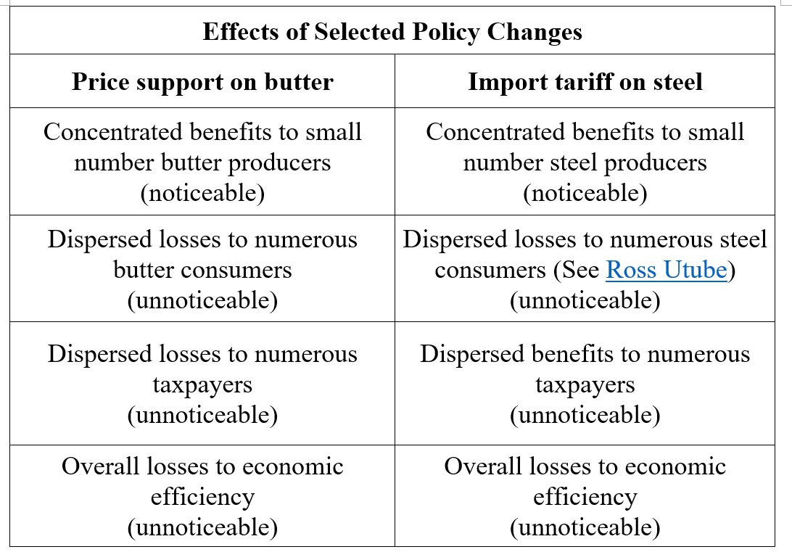

Slide 25
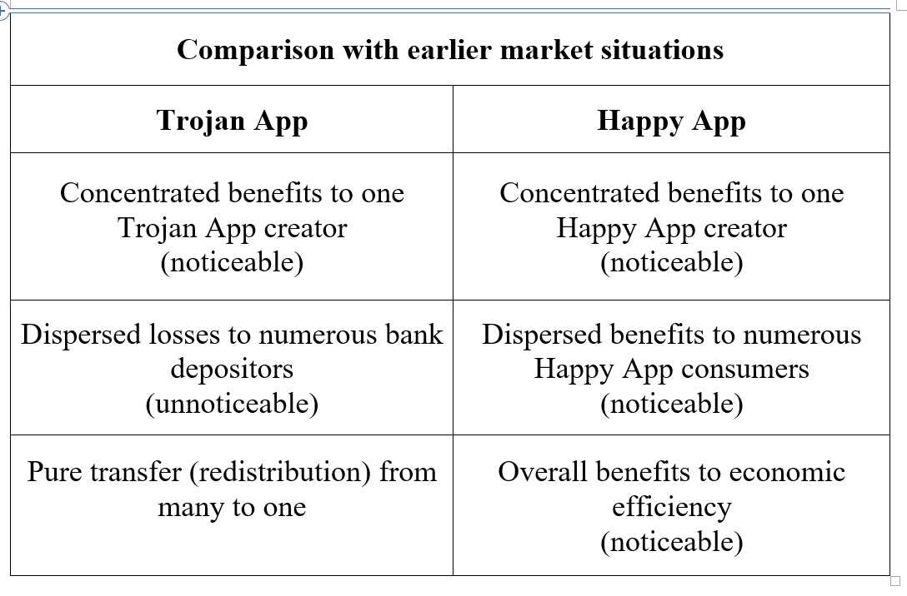

Slide 26
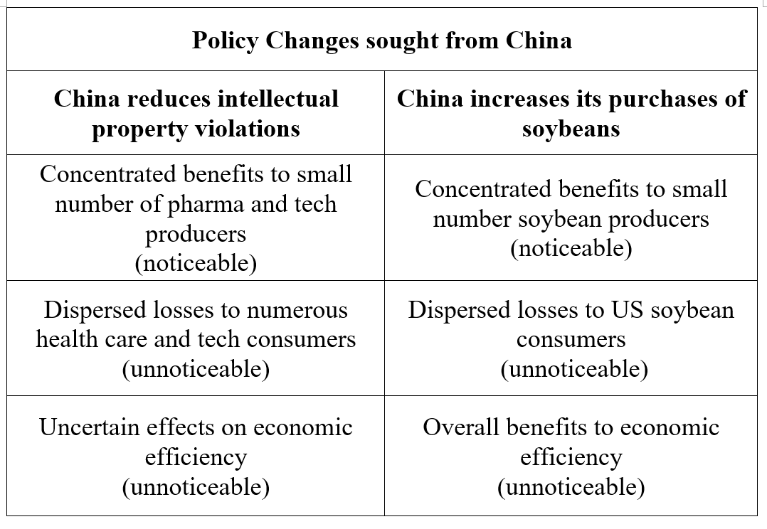

Slide 27
Another Example – US Sugar Supports
Consumers lose an estimated $2 - $4 billion per year
42% of Sugar subsidies go to 5% of sugar growers
Fanjul (sugar) Family in Florida make sizeable campaign contributions regularly
Estimates are they make ~ $60 million in government subsidies per year
Only 61,000 jobs in the sugar industry in US
Most US Free trade agreements have sugar exceptions
US sugar price approx. twice the world price
These are from random internet sources circa 2015. They should be verified before quoting.

